Slide 1

Fast and Curious:
Car Classification
Jake Moon

Slide 2
Table of contents
01
The App
02
Data & Model
04
Business
03
Analysis & Improvements

Slide 3
01
The App
And why users will love this app

Slide 4
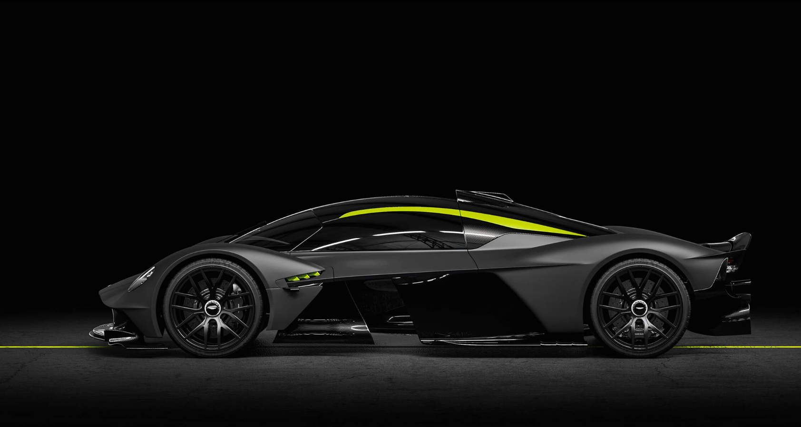
WHAT CAR IS THAT?

Slide 5
Be your own car-expert with just one app
Can you describe the appearance of your favorite car perfectly?
Manufacturer & model
Body type
… what if you don’t know what car it is?
293 car models offered in the U.S. in 2019!
An easier, streamlined experience for identifying and finding cars

Slide 6
Making Car Purchasing EASIER
Take a picture of a car
Confirm results & addit. details
Purchase the best match online
Upload/take picture
Confirm result and additional preferences to receive KellyBlueBook summary and estimate
Direct to favorite car sites such as AutoTrader, CarsDirect, CarGurus with parameters

Slide 7
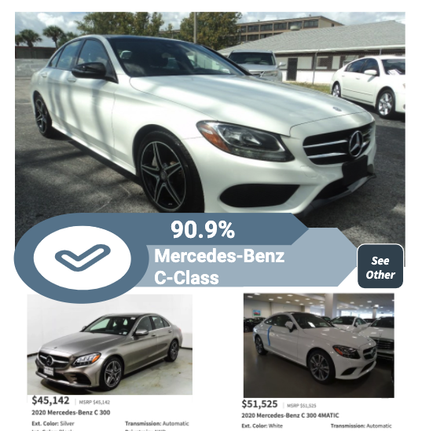
Website
Website powered by Flask and TensorFlow
Easy drag and drop interface
Classify and recommend cars

Slide 8
02
Data & Model
The engine powering our app

Slide 9

ResNet50: winner of ImageNet 2015 challenge using skip connection
 | Images
Ford | 13,965
Chevrolet | 11,316
Toyota | 8,554
Honda | 5,153
Jeep | 4,771
Nissan | 4,535
GMC | 3,885
Ram | 3,468
... | ...
93k image urls from Kaggle car dataset
Scraped images and mapped back to classes from dataset
Class: Make and model
304 imbalanced classes
32 manufacturers
Dealership and street images
X
weight layer
F(x)
relu
X
identity
weight layer
F(x) + x
relu
Notes:
They mitigate the problem of vanishing gradient by allowing this alternate shortcut path for gradient to flow through
They allow the model to learn an identity function which ensures that the higher layer will perform at least as good as the lower layer, and not worse
https://towardsdatascience.com/understanding-and-coding-a-resnet-in-keras-446d7ff84d33

Slide 10

Neural Network Classifier
ResNet50
Average Pooling
Dense
Classifier
Predict
within 304 cars
1024 Node Dense Layer
Global Average Pooling 2D
Prediction:
Manufacturer & Make
50 Layers Pretrained on ImageNet
224x224x3
(x,7,7,2048)
(x,2048)
(x, 1024)
RELU Activation
(x,304)
SoftMax Class Weighting

Slide 11
03
Analysis
Accuracy and improvements

Slide 12
90.6%
97.0%
Validation Accuracy
Top-5 Classification Acc.

Slide 13
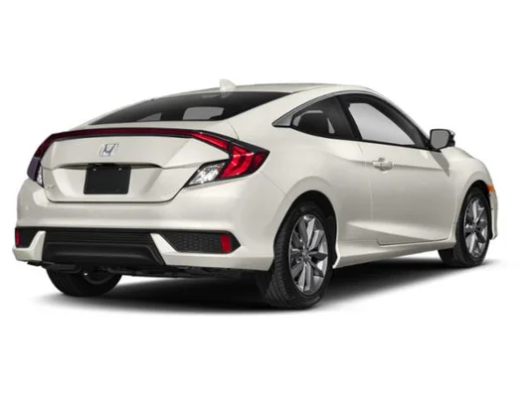
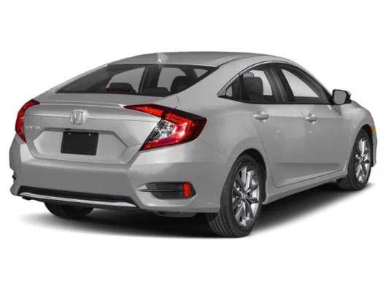
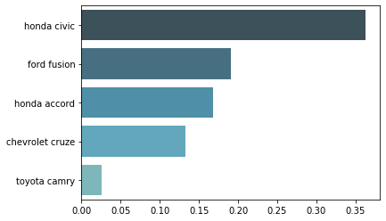
Input: 2020 Honda Civic Coupe EX
Model Performance
Prediction: Honda Civic

Slide 14
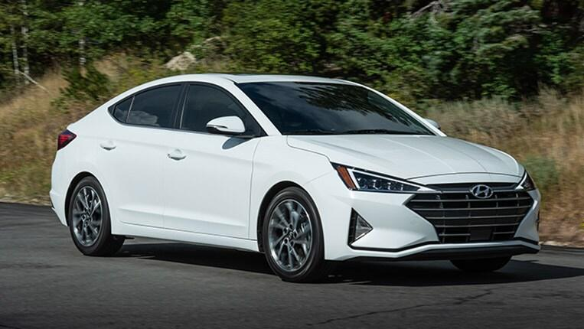
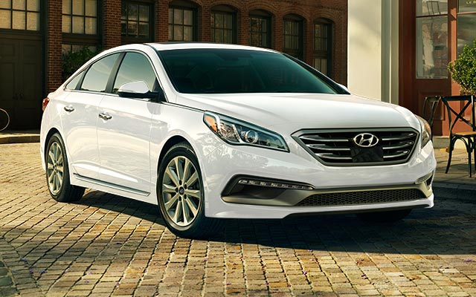
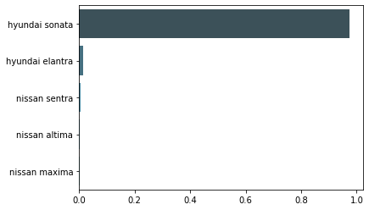
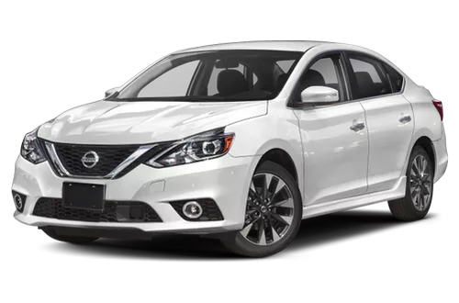
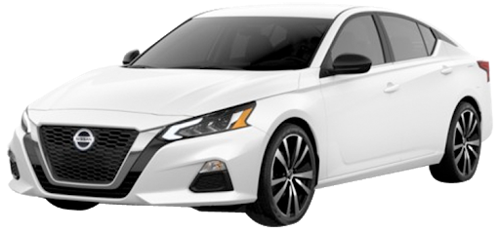
Input: Hyundai Elantra 2019
Model Performance
Prediction: Hyundai Sonata

Slide 15
User Input
Revenue
& Usage Statistics
Business Model and Improvements
Improve Database
Users provide correct labels and own preferences
Commission redirects to car websites and user statistics sent
Images, labels, and user info used to update algorithm with consent of users

Slide 16
Thanks!
Any questions?
Jake Moon
jakekmoon@gmail.com

Slide 17
Appendix
Sources Used:
https://www.statista.com/statistics/200092/total-number-of-car-models-on-the-us-market-since-1990/
https://craigslist.org/
3D Object Representations for Fine-Grained Categorization Jonathan Krause, Michael Stark, Jia Deng, Li Fei-Fei 4th IEEE Workshop on 3D Representation and Recognition, at ICCV 2013 (3dRR-13). Sydney, Australia. Dec. 8, 2013.
ImageNet
https://www.kaggle.com/austinreese/craigslist-carstrucks-data

Slide 18
Slide Credits
This is where you give credit to the ones who are part of this project
Did you like the resources on this template? Get them for free at our other websites
Presentation template by Slidesgo
Icons by Flaticon
Images & infographics by Freepik
Author introduction slide photo created by Freepik
Text & Image slide photo created by Freepik.com
Big image slide photo created by Freepik.com

